Slide 1
Lecture 5
Conditional Jumps
Repetitive Instructions

Slide 2
Control Flow Instructions
The x86 processor maintains an instruction pointer (EIP) register that is a 32-bit value indicating the location in memory where the current instruction starts.
Normally, it increments to point to the next instruction in memory begins after execution an instruction. The EIP register cannot be manipulated directly, but is updated implicitly by provided control flow instructions.
We use the notation <label> to refer to labeled locations in the program code.
Labels can be inserted anywhere in x86 assembly code text by entering a label name followed by a colon.
For example:
mov eax, 3
thisisanexempleforlabel:
mov ebx, 4
The second instruction in this code fragment is labeled thisisanexempleforlabel.
Elsewhere in the code, we can refer to the memory location using the more convenient symbolic name (in this case thisisanexempleforlabel).
This label is just a convenient way of expressing the location instead of its 32-bit value.
Labels often appear on a separate line for code clarity.

Slide 3
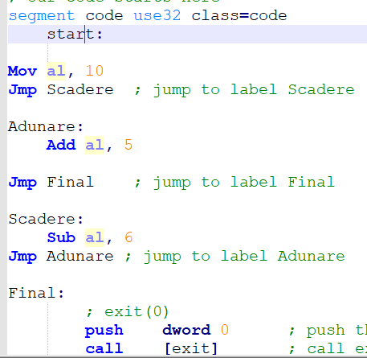
jmp — Unconditional Jump
Transfers program control flow to the instruction at the memory location indicated by the operand.
Syntax:
jmp <label>

Slide 4
CMP Instruction
The CMP (compare) instruction performs an implied subtraction of a source operand from a destination operand. Neither operand is modified:
Syntax: CMP destination, source ; destination-source is performed
destination: reg, mem
source: reg, mem, imm
destination and source – same dimensions
The CMP instruction changes the Overflow, Sign, Zero, Carry, Auxiliary Carry, and Parity flags according to the value the destination operand would have had if actual subtraction had taken place.
Usually a CMP instruction is used follows by a conditional jump.
Notes:
Having examined all of the bitwise instructions, let’s now turn to instructions used in logical (boolean) expressions. At the heart of any boolean expression is some type of comparison. The following pseudocode examples support this idea:
if A > B then ...
while X > 0 and X < 200 ...
if check_for_error( N ) = true then
In Intel assembly language we use the CMP instruction to compare integers. Character codes are also integers, so they work with CMP as well.
The CMP (compare) instruction performs an implied subtraction of a source operand from a destination operand. Neither operand is modified:
CMP instructions syntax is destination,source
CMP uses the same operand combinations as the AND instruction.

Slide 5
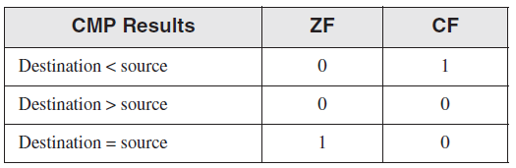
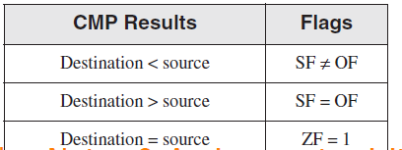
CMP: Flags
The CMP instruction changes the Overflow, Sign, Zero, Carry, Auxiliary Carry, and Parity flags according to the value the destination operand would have had if actual subtraction had taken place.
When two unsigned operands are compared, the Zero and Carry flags indicate the following relations between operands:
When two signed operands are compared, the Sign, Zero, and Overflow flags indicate the following relations between operands:
Notes:
The CMP instruction changes the Overflow, Sign, Zero, Carry, Auxiliary Carry, and Parity flags according to the value the destination operand would have had if actual subtraction had taken place.
When two unsigned operands are compared, the Zero and Carry flags indicate the following relations between operands:
When two signed operands are compared, the Sign, Zero, and Overflow flags indicate the following relations between operands:

Slide 6
Why CMP?
CMP is a valuable tool for creating conditional logic structures.
When we follow CMP with a conditional jump instruction, the result is the assembly language equivalent of an IF statement.
Notes:
CMP is a valuable tool for creating conditional logic structures.
When we follow CMP with a conditional jump instruction, the result is the assembly language equivalent of an IF statement.
(Conditional jump instructions evaluate the flag states,
using them to determine whether or not jumps should be taken.)

Slide 7
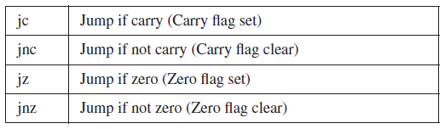
Jcond Instruction
A conditional jump instruction branches to a destination label when a status flag condition is true.
Otherwise, if the flag condition is false, the instruction immediately following the conditional jump is executed.
The syntax is as follows: Jcond destination
cond refers to a flag condition identifying the state of one or more flags
The following examples are based on the Carry and Zero flags:
Notes:
A conditional jump instruction branches to a destination label when a status flag condition is true.
Otherwise, if the flag condition is false, the instruction immediately following the conditional jump is executed.
The syntax is as follows: Jcond destination
cond refers to a flag condition identifying the state of one or more flags
The following examples are based on the Carry and Zero flags:

Slide 8
CMP to create conditional logic structures: Examples
Let’s look at three code fragments showing how flags are affected by the CMP instruction. When AX equals 5 and is compared to 10, the Carry flag is set because subtracting 10 from 5 requires a borrow:
mov ax,5
cmp ax,10 ; 5- 10 => ZF = 0 and CF = 1
JC otherplaceincode (jump if CF = 1)
Comparing 1000 to 1000 sets the Zero flag because subtracting the source from the destination produces zero:
mov ax,1000
mov cx,1000
cmp cx,ax ; 1000-1000 => ZF = 1 and CF = 0
JZ otherplaceincode (jump if ZF is set , ZF=1)
Comparing 105 to 0 clears both the Zero and Carry flags because subtracting 0 from 105 would generate a positive, nonzero value.
mov si,105
cmp si,0 ; 105-0 => ZF = 0 and CF = 0
JNZ otherplaceincode (jump if NOT set ZF, ZF=0)
Notes:
Let’s look at three code fragments showing how flags are affected by the CMP instruction. When AX equals 5 and is compared to 10, the Carry flag is set because subtracting 10 from 5 requires a borrow:
mov ax,5
cmp ax,10 ; ZF = 0 and CF = 1
JC otherplaceincode (jump if CF = 1)
Comparing 1000 to 1000 sets the Zero flag because subtracting the source from the destination produces zero:
mov ax,1000
mov cx,1000
cmp cx,ax ; ZF = 1 and CF = 0
JZ otherplaceincode (jump if ZF is set , ZF=1)
Comparing 105 to 0 clears both the Zero and Carry flags because subtracting 0 from 105 would generate a positive, nonzero value.
mov si,105
cmp si,0 ; ZF = 0 and CF = 0
JNZ otherplaceincode (jump if NOT set ZF, ZF=0)

Slide 9
Cmp destination, source Jcc = jump if destination is in relation (set by jcc) with source.
Code Instruction in ASM (”here” represents a name for a label in code) | Conditional Jumps (Jcc) |  | Relation tested between destination and source | Meaning
 | Signed comparison | Unsigned comparison
cmp destination, source JE here | JE | JE | destination = source | If destination = source then go and execute the code from label here
cmp destination, source JNE here | JNE | JNE | destination ≠ source | If destination ≠ source then go and execute the code from label here
cmp destination, source JG here ; or JA here | JG | JA | destination > source | If destination > source then go and execute the code from label here
cmp destination, source JL here ; or JB here | JL | JB | destination < source | If destination < source then go and execute the code from label here
cmp destination, source JGE here ; or JAE here | JGE | JAE | destination ≥ source | If destination ≥ source then go and execute the code from label here
cmp destination, source JLE here ; or JBE here | JLE | JBE | destination ≤ source | If destination ≤ source then go and execute the code from label here
When comparing two signed numbers, the terms "less than" and "greater than" are used, and when comparing two unsigned numbers, the terms "below" and respectively "above" are used.
The entire list of Conditional Jumps according to Intel IA32 instructions is here: https://www.intel.com/content/www/us/en/developer/articles/technical/intel-sdm.html (starting with page 1058)

Slide 10
Constraints for conditional jumps
Near jump: A jump to an instruction within the current code segment, sometimes referred to as an intrasegment jump (inside the same code segment).
Short jump: A near jump where the jump range is limited to -128 to +127 from the current EIP value (we consider a short jump if consists in 127 lines below from a condition or in 128 lines above from a condition).
Far jump: A jump to an instruction located in a different segment than the current code segment, sometimes referred to as an intersegment jump (for far jumps the code lines should be > 127).

Slide 11
Using the CMP Instruction - Example
Suppose we have: mov eax, 5
We want to jump to label L1 when EAX equals 5.
In the next example, if EAX equals 5, the CMP instruction sets the Zero flag;
then, the JZ instruction produce a jump to L1 because the Zero flag is set:
cmp eax,5
JZ L1 ; jump if Zero Flag=1
...
L1:
But we can use and also JE (jump if EQUAL)
cmp eax,5
JE L1 ; jump to L1 if eax is equal 5
...
L1:
Both jumps are correct and the execution line will jump to the L1 label
Notes:
Suppose we have: mov eax, 5
We want to jump to label L1 when EAX equals 5.
In the next example, if EAX equals 5, the CMP instruction sets the Zero flag;
then, the JZ instruction produce a jump to L1 because the Zero flag is set:
cmp eax,5
JZ L1 ; jump if Zero Flag=1
...
L1:
But we can use and also JE (jump if EQUAL)
cmp eax,5
JE L1 ; jump to L1 if eax is equal 5
...
L1:
Both jumps are correct and the execution line will jump to the L1 label

Slide 12
CMP in arithmetic expressions
Use a 32-bit divisor and 64-bit dividend to reduce the probability of a divide overflow condition.
In the following code, the divisor is EBX, and the dividend is placed in the 64-bit combined EDX and EAX registers:
mov eax,1000h
cdq
mov ebx,10h
div ebx ; EAX = 00000100h
To prevent division by zero, we test the divisor before dividing:
mov ax, [dividend]
mov bl, [divisor]
cmp bl,0 ; check the divisor
je NoDivideZero ; zero? display error
div bl ; not zero: continue
.....
NoDivideZero: ; (display "Attempt to divide by zero")
Notes:
For instance we can use cmp in artihhm expresions:
Use a 32-bit divisor and 64-bit dividend to reduce the probability of a divide overflow condition.
In the following code, the divisor is EBX, and the dividend is placed in the 64-bit combined EDX and EAX registers:
mov eax,1000h
cdq
mov ebx,10h
div ebx ; EAX = 00000100h
To prevent division by zero, test the divisor before dividing:
mov ax, [dividend]
mov bl, [divisor]
cmp bl,0 ; check the divisor
je NoDivideZero ; zero? display error
div bl ; not zero: continue
.....
NoDivideZero: ; (display "Attempt to divide by zero")

Slide 13
Exemples: cmp and Jcc
if a mod 2 = 0 then rez = a*3, a-byte
Unsigned | Signed
mov al, [a] | mov al, [a]
mov ah, 0 | cbw
mov bl, 2 | mov bl, 2
div bl ;ax/bl = al cat si ah rest | idiv bl ;ax/bl = al cat si ah rest
cmp ah, 0 | cmp ah, 0
JE ramura_then | JE ramura_then
Jmp final ; JNE final | Jmp final ; JNE final
ramura_then: | ramura_then:
mov al,[a] | mov al,[a]
mov bl, 3 | mov bl, 3
mul bl ; ax=a*3 | imul bl ; ax=a*3
mov [rez], ax | mov [rez], ax
final: | final:
if c>d then c=c-1 else c=c+2
c, d - bytes
Unsigned |  | Signed
mov al, [c] |  | mov al, [c]
mov bl, [d] |  | mov bl, [d]
cmp al, bl |  | cmp al, bl
JA then_eticheta |  | JG then_eticheta
JNA else_eticheta |  | JNG else_eticheta
then_eticheta: |  | then_eticheta:
 | sub al, 1 |  | sub al, 1
jmp final |  | jmp final
else_eticheta: |  | else_eticheta:
 | add al, 2 |  | add al, 2
final: |  | final:

Slide 14
LOOP Instruction
The LOOP instruction, formally known as Loop According to ECX Counter, repeats a block of
statements a specific number of times.
ECX is automatically used as a counter and is decremented each time the loop repeats.
The syntax is: LOOP destination
The execution of the LOOP instruction involves two steps:
First, it subtracts 1 from ECX.
Next, it compares ECX to zero.
If ECX is not equal to zero, a jump is taken to the label identified by destination.
Otherwise, if ECX equals zero, no jump takes place, and control passes to the instruction following the loop.
Notes:
The loop destination must be within 128 to +127 bytes of the current location counter.

Slide 15
Loop instruction: example
Mov ax, 0
MOV ECX, 5
Repeta:
add ax, 1
LOOP Repeta
; the final value in ax = 5
Mov ax, 0
MOV ECX, 5
Repeta:
add ax, 1
sub ecx, 1 (;sau dec ecx)
cmp ecx, 0
JNE Repeta

Slide 16
Compute the number of bits with value 1 from ebx register.
mov ebx, 11110100b
mov ecx, 32
mov al, 0
repeta:
shl ebx, 1 ; ebx = 11101000b , CF = 1
adc al, 0
loop repeta
mov ebx, 11110100b
mov ecx, 32
mov al, 0
repeta:
shl ebx, 1 ; ebx = 11101000b , CF = 1
adc al, 0
dec Ecx
cmp Ecx, 0
JNE Repeta

Slide 17
Nested Loops
When creating a loop inside another loop, special consideration must be the outer loop counter in ECX. We can save it in a variable (eg: variable count defined in data segment)
mov ecx,100 ; set outer loop count
L1:
mov [count], ecx ; save outer loop count
mov ecx, 20 ; set inner loop count
L2:
....
loop L2 ; repeat the inner loop
mov ecx, [count] ; restore outer loop count
loop L1 ; repeat the outer loop
As a general rule, nested loops more than two levels deep are difficult to write. If the algorithm requires deep loop nesting, we need to move some of the inner loops into subproblems.

Slide 18
Variants of loop
If the ending conditions of the cycle are more complex, the LOOPE and LOOPNE instructions can be used.
The LOOPE statement (LOOP while Equal) differs from LOOP by the termination condition, the cycle terminating either if ECX = 0 or ZF = 0.
For LOOPNE (LOOP while Not Equal), the cycle will end either if ECX = 0 or if ZF = 1. Even if the cycle output is based on the value in the ZF, the ECX is still decremented.
LOOPE is also known as LOOPZ and LOOPNE is also known as LOOPNZ. These instructions are usually preceded by a CMP or SUB statement.

Slide 19
LOOPZ and LOOPE
• Syntax:
LOOPE destination
LOOPZ destination
• Logic:
• ECX ← ECX – 1
• if ECX > 0 and ZF=1, jump to destination
LOOPNZ (LOOPNE)
• Syntax:
LOOPNZ destination
LOOPNE destination
• Logic:
ECX ← ECX – 1;
if ECX > 0 and ZF=0, jump to destination

Slide 20
Particular jumps: JECXZ and JCXZ
The JECXZ and JCXZ instructions are conditional jump instructions but differ from the standard set of these instructions by not checking the status of the flags.
JECXZ and JCXZ only check if the content in ECX or CX is 0.
These instructions can be used at the beginning of a loop ending with a conditional loop to prevent loop entry when the ECX or CX is 0.
If it enters the loop with ECX = 0, given that "first decrementing of the ECX register is performed and then the test is performed and possibly the jump" this will cause the execution of a loop of 2 ^ 32 times or 2 ^ 16 times, instead of 0 times such as normal based on (E)CX = 0.

Slide 21
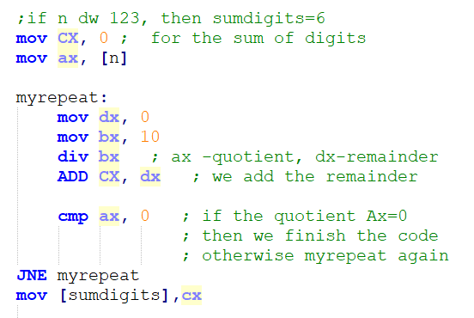
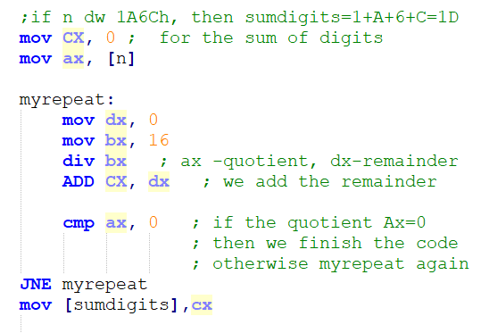
Compute the sum of digits of a number.

Slide 22
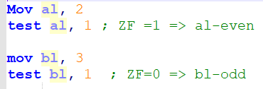
Test instruction
Computes the bit-wise logical AND of first operand (source 1 operand) and the second operand (source 2 operand) and sets the SF, ZF, and PF status flags according to the result.
The result is not saved
We can use TEST to check the parity of an operand:
TEST op, 00000001b
If result of test = 0 then op is even
else op is odd

Slide 23
Compute the sum of odd digits and the sum of even digits for a natural number in base 10.
N=1234
Sod = 4
Sed = 6

Slide 24
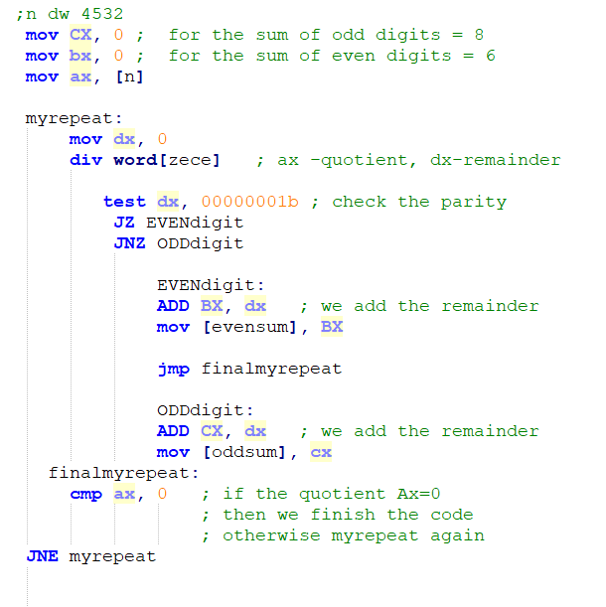
Compute the sum of odd digits and the sum of even digits for a natural number in base 10.

